Slide 1
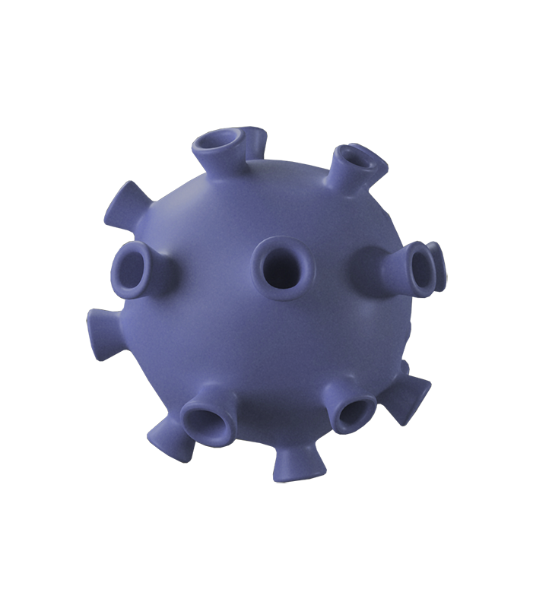
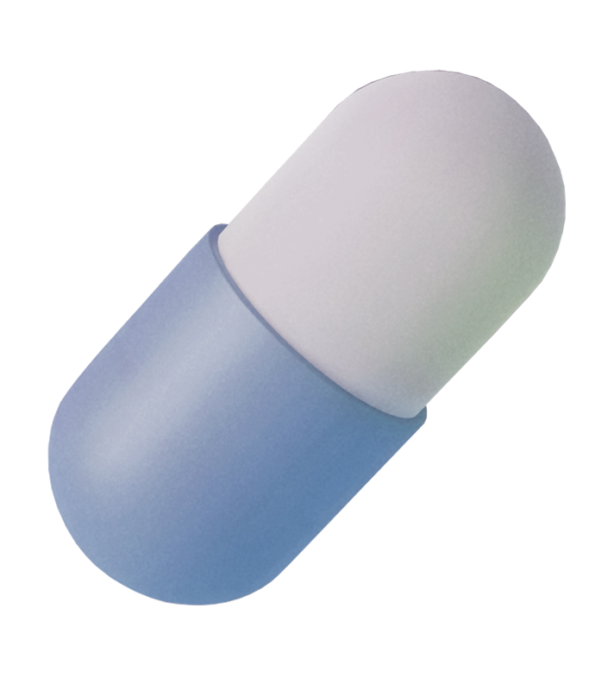
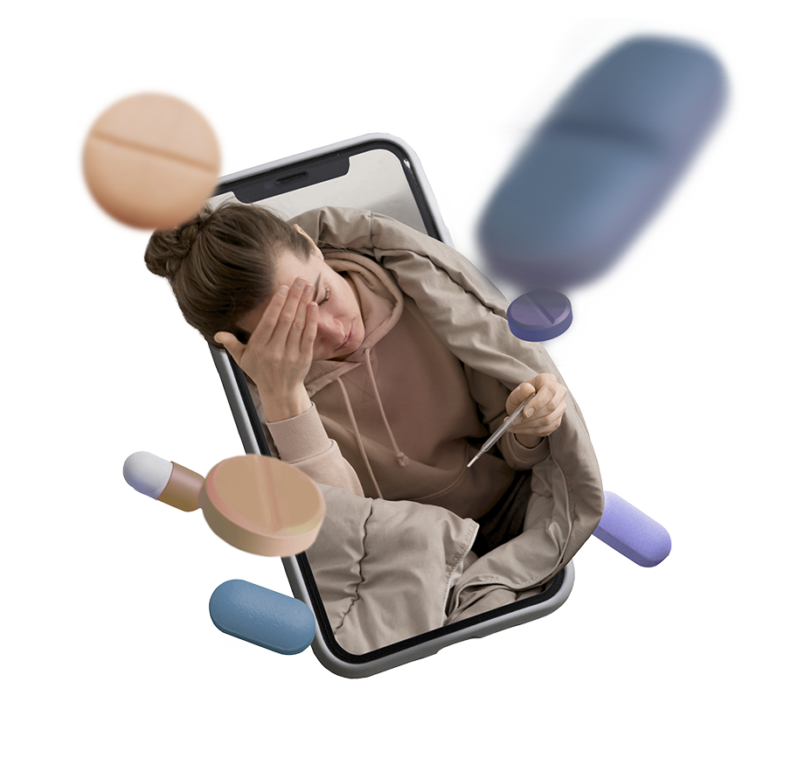

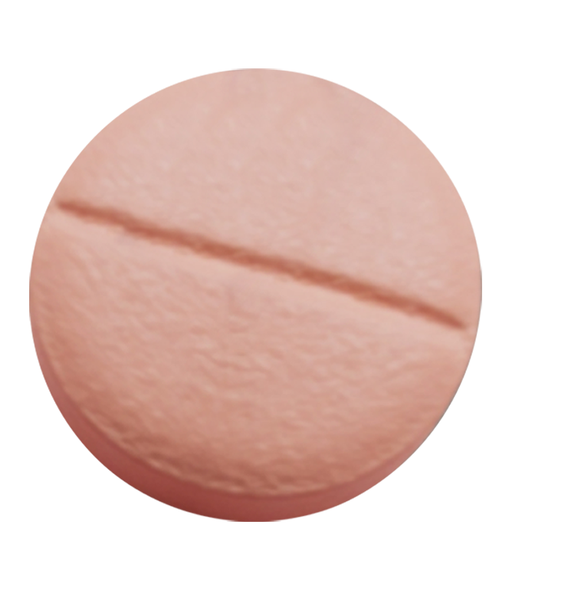
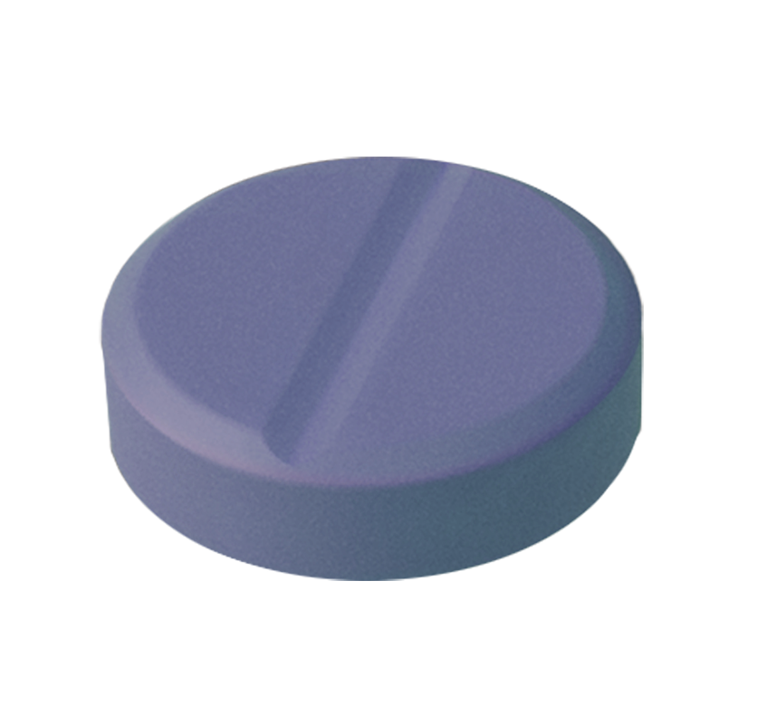
Efficient Health Diagnosis with 5G and Blockchain Technology Using IoHT

Slide 2
Abstract
The patient information management platform can transform the delivery of healthcare. It may offer patients personalized care and monitoring from a distance, automate patient data sharing between authorized healthcare providers, and generate real-time notifications for healthcare professionals when a patient’s health state changes. This can result in higher healthcare quality, lower healthcare costs, improved effectiveness, medical outcomes, or increased patient safety. The system collects, stores, analyses, and shares patient data securely and efficiently by combining IoT devices, blockchain technology, AI, machine learning, and 5G. Patients will have access to their analysis to make educated decisions regarding their care. Healthcare practitioners will receive immediate information on their patient’s health state, which will allow them to deliver better care and spot potential health issues earlier.

Slide 3
The technology can also be used to simplify the exchange of patient data among authorized healthcare practitioners, saving time and money. Furthermore, when an individual’s condition changes, the system can create immediate notifications for healthcare personnel, which can help to reduce medical errors and increase patient safety. The proposed system has been tested using a number of machine learning classification algorithms, and the results suggest that the system is capable of identifying disease and degree of severity with high accuracy. The technology has also been proven to be useful in providing healthcare providers with real-time notifications
Key Words--IOHT,BLOCKCHAIN,5G,AIML,SMART CONTRACTS

Slide 4
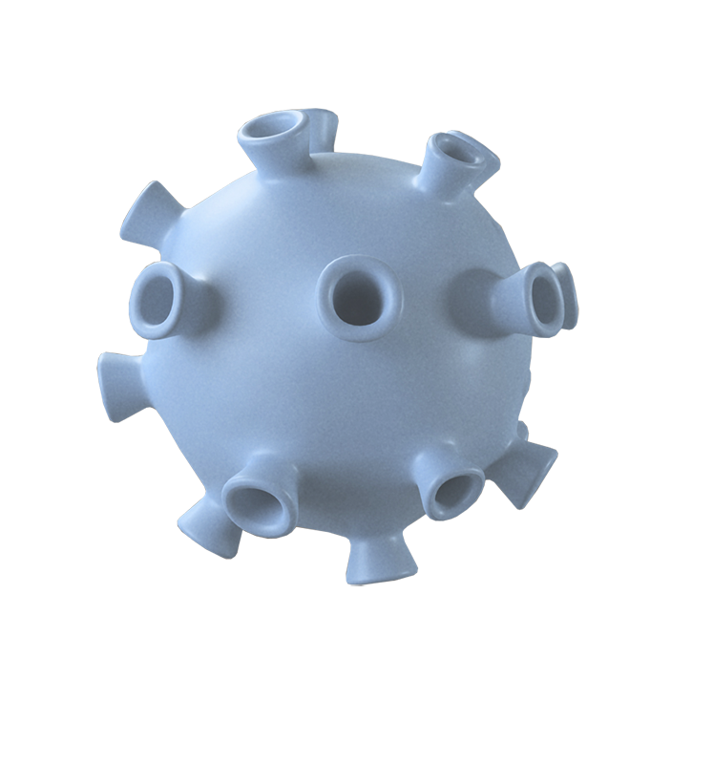
INTRODUCTION
The Internet of Things (IoT) is a rapidly growing field with a wide range of potential applications in the healthcare sector. IoT-based patient data management systems have the potential to revolutionize the way healthcare is delivered, by providing personalized care, remote patient monitoring, and real-time alerts for healthcare providers. The proposed system is a blockchain-based patient data management system that uses AI and machine learning algorithms to process and analyze patient data in real-time. The system can identify potential health problems and generate personalized treatment recommendations. It can also provide remote patient monitoring and telehealth services.

Slide 5

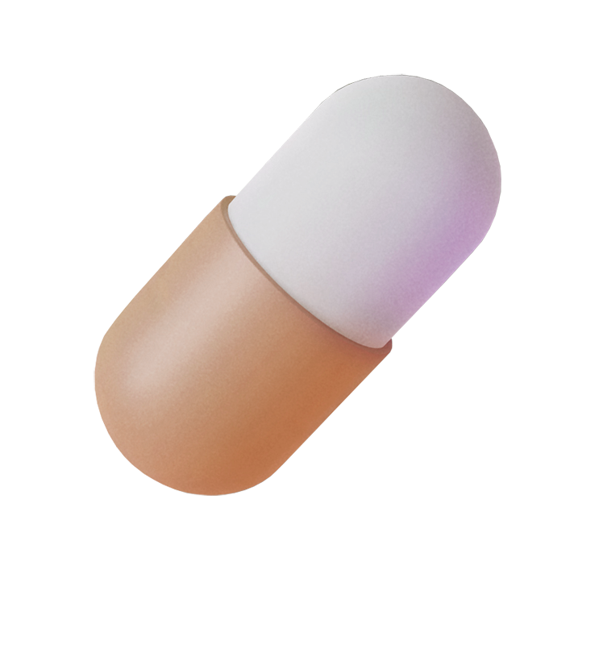

Smart contracts are used to automate the sharing of patient data between authorized healthcare providers. Additionally, the system can generate real-time alerts for healthcare providers when a patient’s health status changes. It has a number of advantages over traditional patient data management systems. First, the use of blockchain technology helps to improve the security and privacy of patient data.

Slide 6
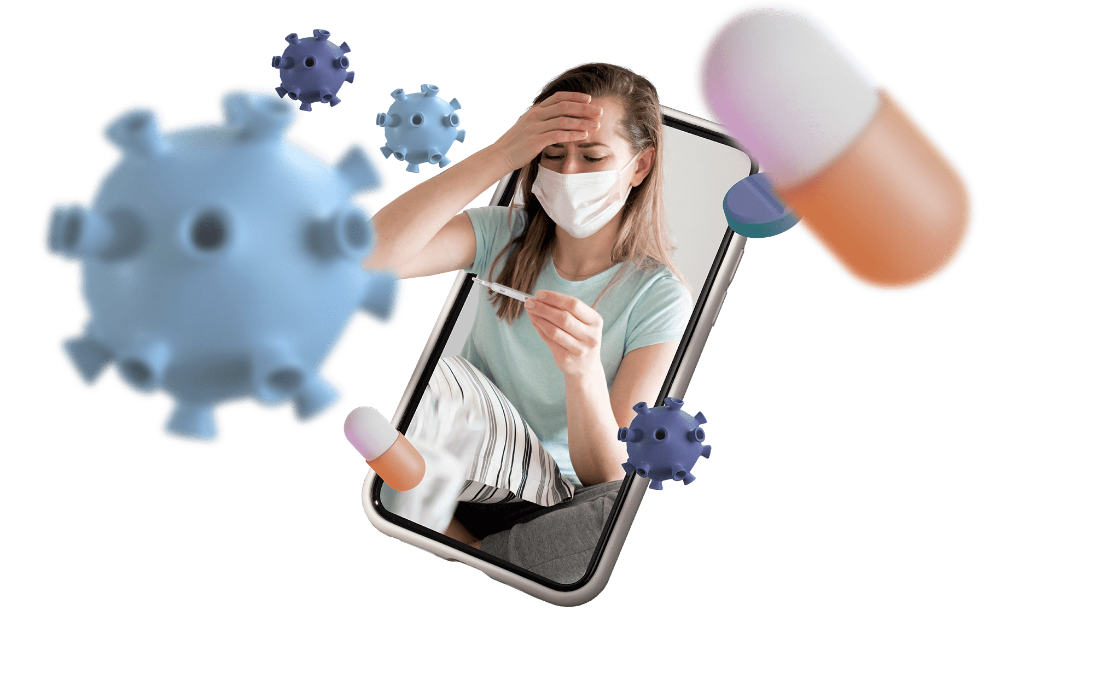
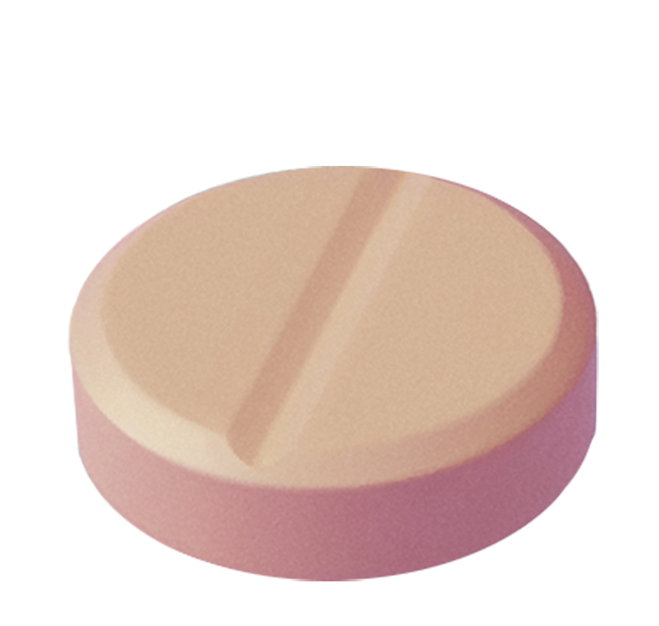
Second, the use of AI and machine learning algorithms allows the system to provide personalized care and real-time alerts for healthcare providers. Third, the system is designed to be scalable and efficient. The proposed system has the potential to improve the quality and efficiency of healthcare delivery. By providing personalized care, remote patient monitoring, and real-time alerts for healthcare providers, the system can help improve patient outcomes and reduce healthcare costs. The patient data management system described above has the potential to revolutionize the way healthcare is delivered. It can provide patients with personalized care and remote patient monitoring, while also automating the sharing of patient data between authorized healthcare providers.

Slide 7
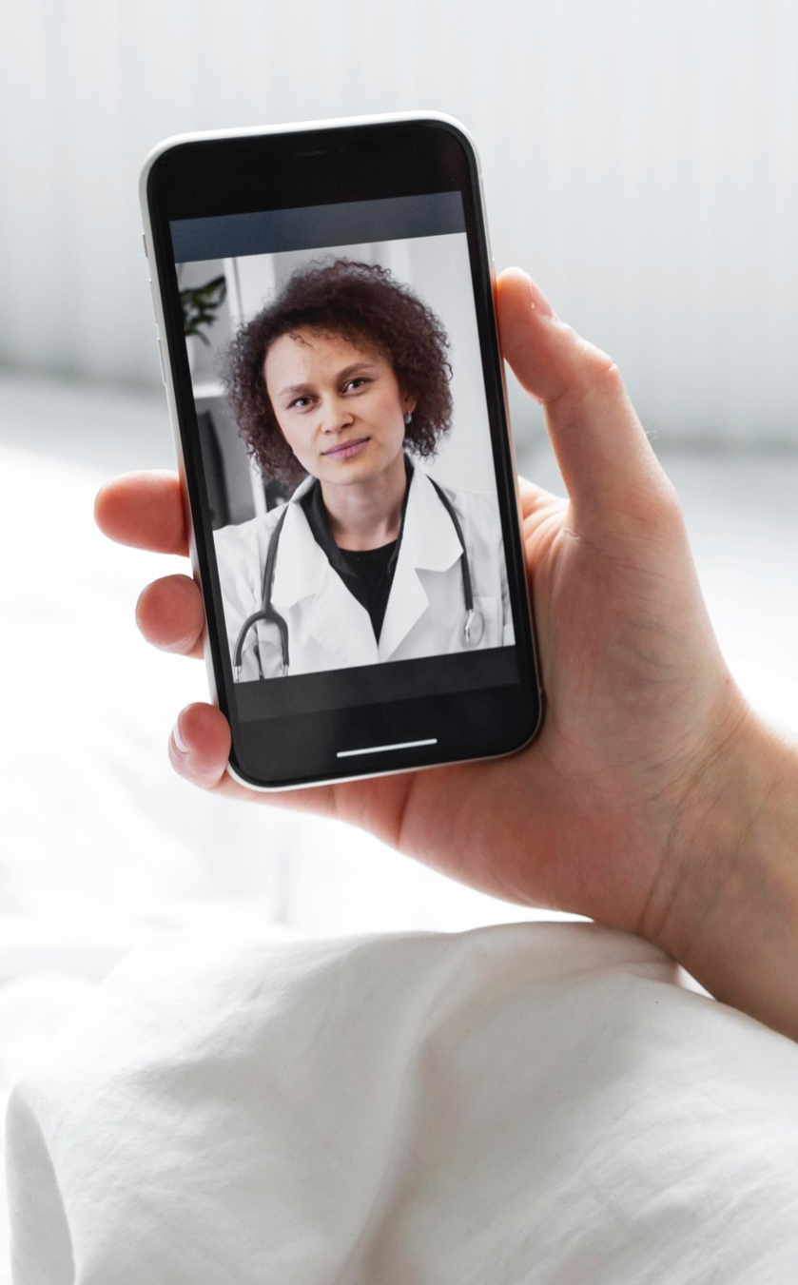
This can lead to improved healthcare quality, reduced healthcare costs, increased efficiency, and better healthcare outcomes. Patients will be empowered to make informed decisions about their care with access to their own health data. Healthcare providers will have access to real-time data on their patients’ health status, which can help them to provide better care. Remote patient monitoring and telehealth services will help to reduce the need for expensive hospital visits, resulting in reduced healthcare costs. Smart contracts can automate the sharing of patient data between authorized healthcare providers, which can save time and money, resulting in increased efficiency. Overall, the system has the potential to make healthcare more accessible, affordable, and efficient. In addition to the above benefits, the system can also help to improve healthcare outcomes by providing patients with personalized care and by identifying potential health problems early on. The system can also help to reduce the risk of medical errors by automating the sharing of patient data between authorized healthcare providers

Slide 8
proposed system for an IoT-based patient data management system leverages the following technologie
IoHT devices are used to collect patient data. These devices can be wearable devices, such as smartwatches and fitness trackers, or implanted devices, such as pacemakers and insulin pumps. Blockchain: Blockchain is a distributed ledger technology that allows for secure, transparent, and tamper-proof transactions. Blockchain can be used to store and manage patient data in a secure and confidential manner. Additionally, blockchain can be used to track the provenance of patient data and ensure that it has not been tampered with. AI and ML are used to analyze patient data and generate insights and recommendations. For example, AI and ML can be used to develop personalized care plans for patients, identify potential health risks, and predict patient outcomes.5G is the fifth generation of cellular network technology. 5G offers high speeds, low latency, and high capacity, which are essential for enabling real-time remote patient monitoring and other IoT-based healthcare applications.

Slide 9
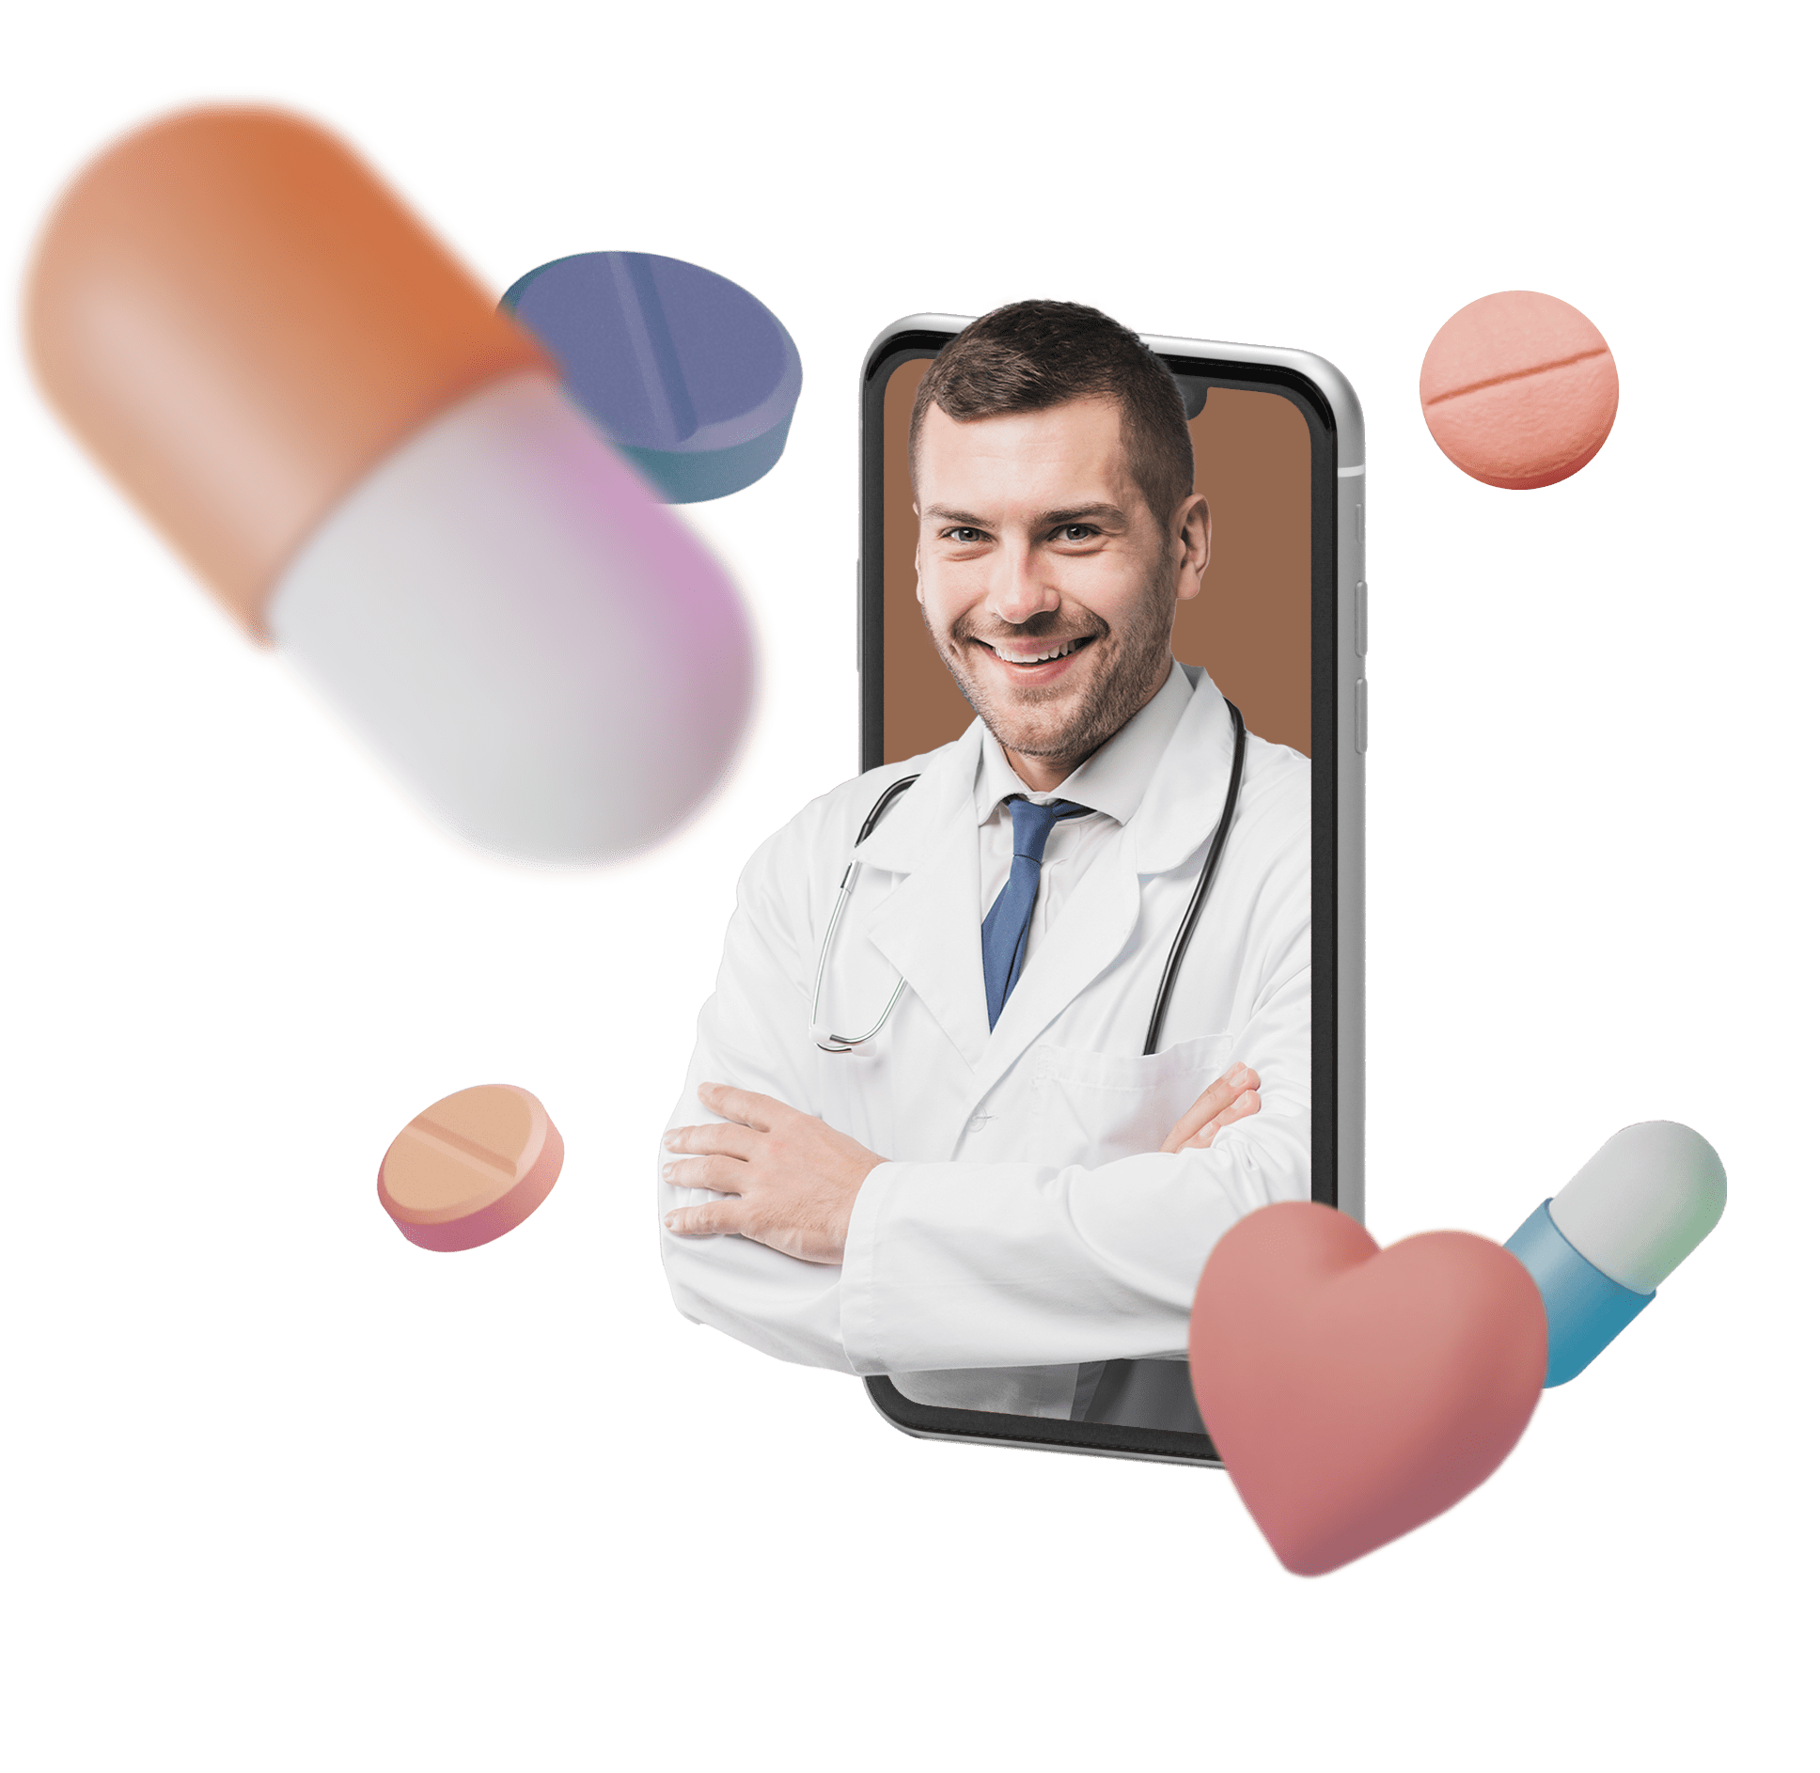
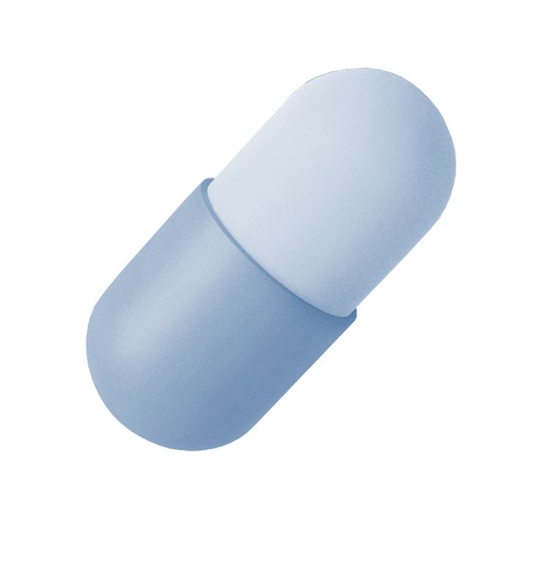
Cloud-based AI and machine learning algorithms process and analyze data in real time using smart contrast:
Collecting data from multiple sources: Cloud-based AI and machine learning algorithms can collect data from multiple sources, such as wearable devices, implanted devices, environmental sensors, and electronic health records (EHRs). This allows them to get a more complete picture of the user’s health. Processing data in real time: Cloud-based AI and machine learning algorithms can process data in real time, which means that they can generate insights and recommendations immediately. This is important for health IoT applications where real-time feedback is critical, such as for monitoring patients with chronic diseases. Using smart contrast: Cloudbased AI and machine learning algorithms can use smart contrast to compare the user’s data to data from other users with similar characteristics, such as age, gender, and health history. This allows them to identify patterns and trends that would be difficult or impossible to detect manually.

Slide 10
PROPOSED SYSTEM
Telemedicine using 5G, blockchain, IoT, AI, and ML with smart contrast:
The proposed telemedicine system uses a combination of emerging technologies, including 5G, blockchain, IoHT, AI, and ML with smart contrast, to address the limitations of the existing system. 5G offers high bandwidth, low latency, and high capacity, which is essential for transmitting highquality video and audio streaming for telemedicine applications. Blockchain: Blockchain can be used to securely store and share patient data. IoHT devices can be used to collect a wide range of patient data, such as vital signs, blood sugar levels, and activity levels.This data can be transmitted to healthcare providers in real time, which can help to improve the quality of care.AI and ML algorithms can be used to analyze patient data and identify patterns and trends that would be difficult or impossible to detect manually. Smart contrast can be used to compare the patient’s data to data from other users with similar characteristics. This allows AI and ML algorithms to identify patterns and trends that would be difficult or impossible to detect manually.

Slide 11
Benefits of the Proposed System:
• Improved quality of care: The proposed system uses advanced technologies to provide higher quality care to patients. For example, 5G enables real-time video conferencing with high-quality video and audio streaming, which can help healthcare providers to better diagnose and treat patients.
• Enhanced security and privacy: The proposed system uses blockchain to securely store and share patient data, which can help to improve the security and privacy of patient data.
• Reduced costs: The proposed system can help to reduce the costs associated with healthcare by allowing patients to receive care remotely. Additionally, the use of AI and ML algorithms can help to reduce the workload on healthcare providers, which can free them up to focus on more complex and critical tasks.

Slide 12
Process flow of the proposed system:
IoHT devices collect patient data and transmit it to the cloud-based patient data management system over a secure 5G network. The cloud-based patient data management system uses blockchain technology to store and manage patient data in a secure and confidential manner. AI and ML algorithms are used to analyze patient data and generate insights and recommendations. The cloud-based patient data management system provides healthcare providers and patients with access to insights and recommendations through a web portal or mobile app. Healthcare providers can use the insights and recommendations to develop personalized care plans for patients and to monitor their health status remotely. Real-time alerts are generated when a patient’s health status changes significantly, so that healthcare providers can intervene promptly.

Slide 13
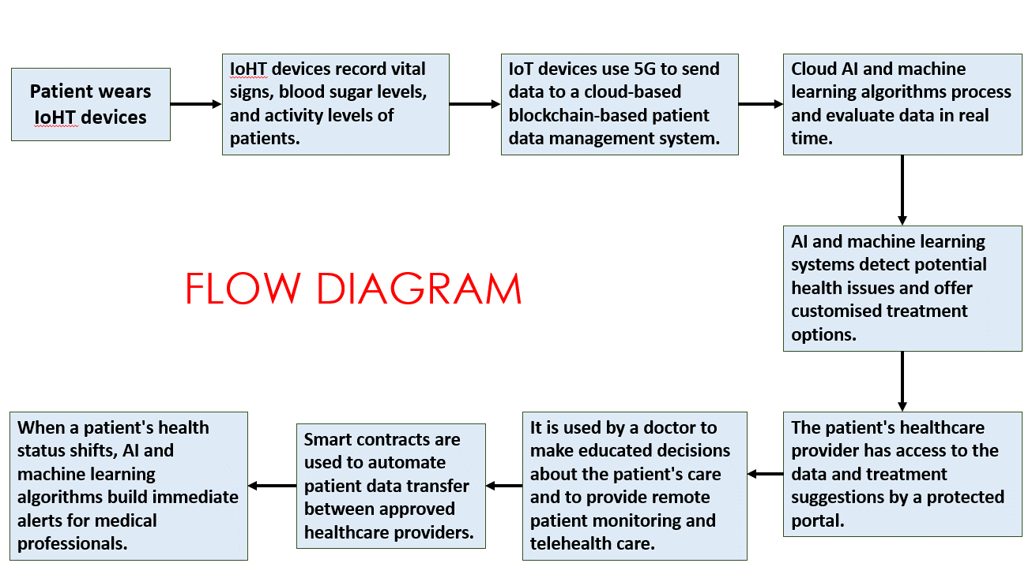


Slide 14
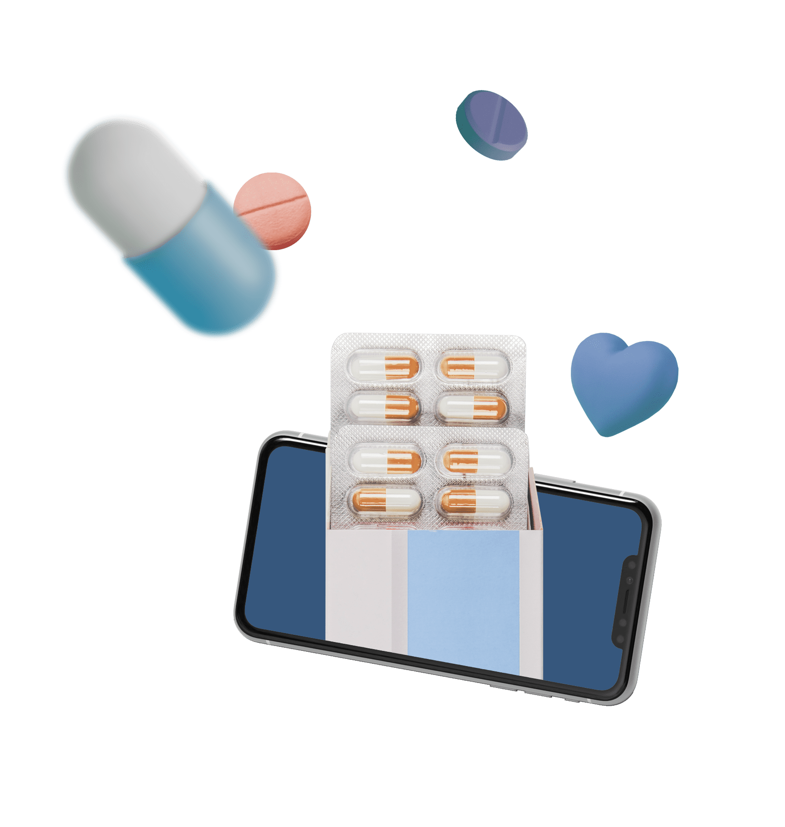
EQUATIONS:
• IoHT Data Collection:
Data collected from IoHT devices as a function of time:
Data(t) = f(t).
• 5G Data Transmission:
Latency in 5G communication:
Latency = Transmission Delay + Propagation Delay+ Processing Delay
• Blockchain Data Storage:
Blockchain data hashing:
H(data) = HashValue
H(data) is the result of applying a cryptographic hash function to the patient data.

Slide 15
• AI and ML Data Analysis:
General data analysis equation:
AnalysisResult = MLAlgorithm(Data)
• Healthcare Insights and Recommendations:
Personalized Care Plan Equation:
CarePlan = MLAlgorithm(Data, PatientInfo)
CarePlan represents the personalized care plan generated for the patient. PatientInfo includes the patient’s characteristics and medical history.
• Real-Time Alerts:
Alert Generation: if (HealthStatusChange <Threshold) then GenerateAlert

Slide 16
The Solid Intersection of 5G and Blockchain for Enhanced Efficiency and Security is Transforming Healthcare:
5G and blockchain technologies are inextricably linked, providing a symbiotic alliance that greatly improves the efficiency and security . The 5G network’s high-speed, low-latency network enables real-time data collection and transfer from IoHT devices to the cloud-based patient data management system, guaranteeing that healthcare data flows quickly and smoothly. At the same time, blockchain technology functions as an immutable, decentralized ledger, securely storing and managing patient data while ensuring its security and integrity. This collaborative synergy between 5G and blockchain not only accelerates data transfer but also strengthens healthcare data security and trustworthiness, fostering a robust ecosystem for seamless analysis, personalized care, and real-time monitoring, ultimately advancing patient care and safet

Slide 17
Transforming Healthcare Practices Through IoHT, AI, and Machine Learning Collaboration:
IoHT devices serve as data collectors in an integrated healthcare ecosystem, supplying a steady stream of patient data into the system. The analytical powerhouse is AI and machine learning algorithms, which understand and interpret this data to provide meaningful insights and suggestions. These insights are made available via a user-friendly site or mobile app, which connects healthcare providers and patients to a plethora of individualized information. This smooth integration of IoHT, AI, and machine learning not only speeds data collection but also equips healthcare practitioners with the knowledge needed to construct personalized treatment plans and conduct remote health monitoring. Real-time warnings prompted by important health status changes enable timely interventions, underscoring the critical role these technologies play in advancing healthcare delivery, improving patient care, and ensuring rapid reactions to shifting health conditions

Slide 18
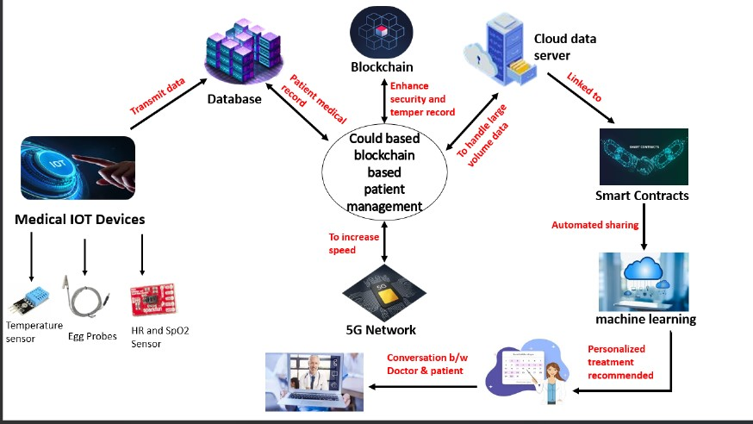
SYSTEM ARCHITECTURE

Slide 19
The Impact of 5G, Blockchain, IoHT, AI, and Machine Learning on Patient-Centric Solutions:
The combined power of 5G, blockchain, IoHT, AI, and machine learning is critical in improving patient care in this advanced healthcare ecosystem.IoHT devices collect patient data, which is quickly transferred over a secure 5G network, allowing for real-time monitoring and rapid treatments.Blockchain technology provides transparency and tamper-proof security for this data, creating trust in its integrity and provenance. Then, AI and machine learning take over, using this data to provide specific insights and suggestions, assisting healthcare providers in developing customized treatment plans and predicting patient outcomes. Furthermore, the cloud-based infrastructure enables seamless data gathering and processing from numerous sources, ensuring a complete picture of the patient’s health. This integrated network streamlines healthcare processes, promotes proactive care, and equips both patients and clinicians with tools for improved, data-driven healthcare practices.

Slide 20
Key Components and Functions in Healthcare Technologies:
This table shows the essential elements and technology driving healthcare delivery transformation. It gives an overview of each element’s vital functions and key equations/concepts. The 5G network, blockchain technology, IoHT devices, AI and machine Learning, tailored treatment plans, cloud-based infrastructure, and user interfaces (websites/apps) are among these components. Each of these is critical in transforming healthcare for better patient outcomes, costeffectiveness, and accessibility

Slide 21
Component | Function/Technology | Key Equations/Concepts (if applicable)
5G Network | High-speed, low-latency network | - Data Transfer Speed: Speed = Distance / Time
Blockchain | Data security and integrity | - Data Integrity Check using Hashing: H(data) = HashValue
IoHT Devices | Data collection | - Data Integration: IntegratedData = f(Data1, Data2, ..., DataN)
AI & Machine Learning | Data analysis and insights | - Data Analysis: AnalysisResult = ML_Algorithm(Data)
Customized Treatment Plans | Personalized care recommendations | - Personalized Care Plan: CarePlan = ML_Algorithm(Data, PatientInfo)
Cloud-Based Infrastructure | Data gathering and processing | - Data Processing Efficiency: Efficiency = (ProcessedData / TotalData) * 100%
User Interface (Website/App) | Presentation and interaction | - Usability Metrics: User Satisfaction, Task Completion Time, Error Rate

Slide 22
Visualized representation

Slide 23
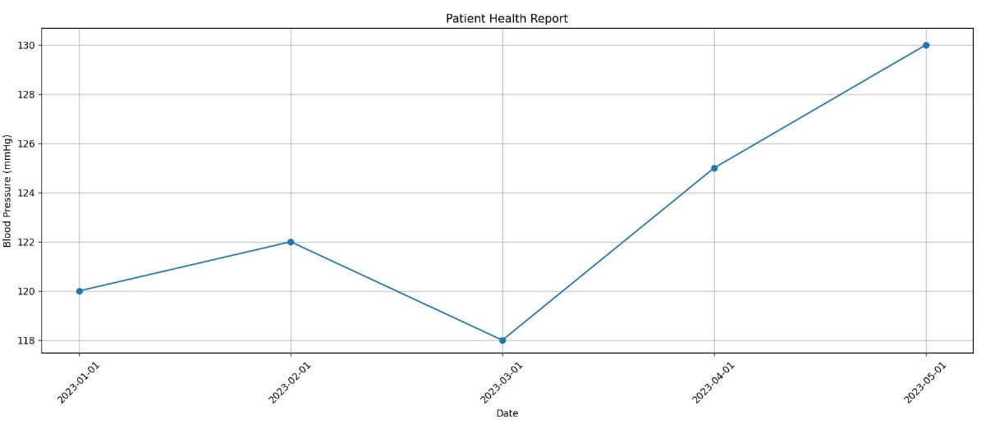
BLOOD PRESSURE
graph to visualize a patient's blood pressure over time. It uses Matplotlib and provides key details, including markers, axis labels, and a title for clear data representation. The resulting graph is displayed for health professionals to assess the patient's cardiovascular health.

Slide 24
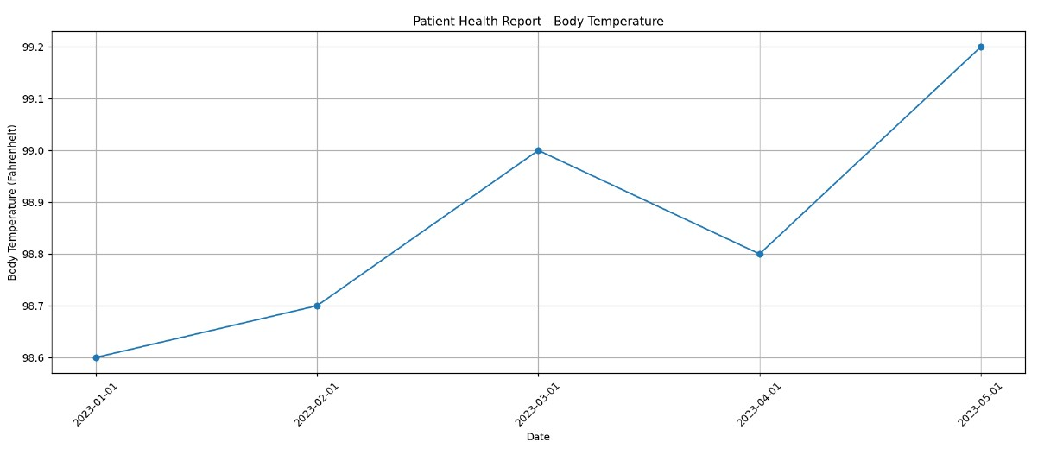
BODY TEMPERATURE
Graph illustrating a patient's body temperature changes over a period of time. It utilizes Matplotlib to create the graph, adds labels for clarity, and displays the information in a clear and visually appealing format. This graph is a part of the "Patient Health Report - Body Temperature," aiding healthcare professionals in monitoring the patient's health.

Slide 25
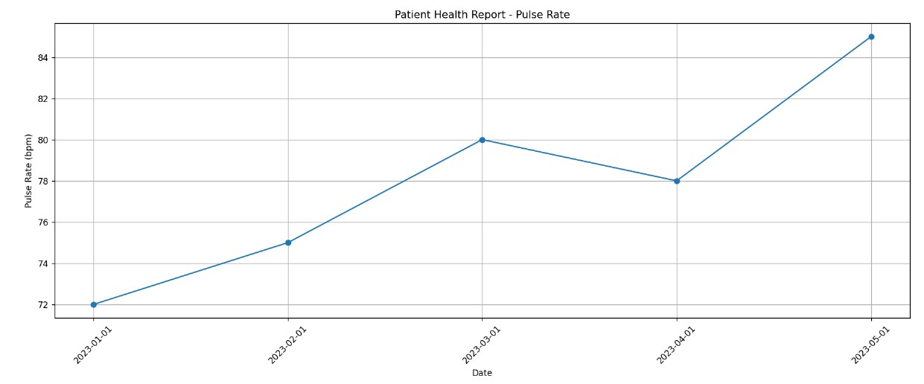
PULSE RATE
Graph illustrating a patient's pulse rate over a period of time. It employs Matplotlib to create the graph, includes axis labels and a title for clarity, and displays the data in a visually informative manner. This graph is part of the "Patient Health Report - Pulse Rate," helping healthcare professionals track the patient's cardiac health.

Slide 26
LITERATURE SURVEY
Telemedicine, facilitated by the amalgamation of 5G networks, blockchain technology, and the Internet of Things (IoT), has emerged as a transformative paradigm in modern healthcare. This survey synthesizes pivotal research contributions at the intersection of these technologies, delineating their potential to revolutionize efficient health diagnosis. The pivotal role of 5G networks in telemedicine cannot be overstated [1]. With ultra-low latency and high bandwidth capabilities, 5G enables realtime remote consultations, improving diagnostic accuracy [2]. Additionally, multi-access edge computing (MEC) within 5G infrastructure facilitates real-time data processing, a prerequisite for timely diagnostics [1]. Blockchain technology addresses critical concerns surrounding health data integrity [3] [4]. Its decentralized and tamper-proof data storage ensures data veracity from IoT devices, while patient-centric control enhances privacy [5]. Furthermore, blockchain’s transparency fosters interoperability across heterogeneous healthcare systems [6].

Slide 27
The IoT’s emergence as a conduit for realtime monitoring enhances personalized health diagnosis [7]. Wearables and sensors provide continuous patient monitoring, enabling early detection of health issues [8]. This realtime data collection empowers remote consultations through datadriven insights [9]. The synergy of 5G, blockchain, and IoT enriches telemedical applications [10] [11] [12]. Secure data transmission in 5G-enabled environments is guaranteed by blockchain [13]. Patients gain control over their IoT-generated data, enhancing selective data sharing with healthcare providers [14]. Despite promises, challenges persist [15]. Scaling blockchain solutions to accommodate vast IoT-generated data is imperative [16]. Energy efficiency concerns tied to blockchain’s consensus mechanisms warrant attention [17]. Harmonizing 5G, blockchain, and IoT technologies necessitates standardized frameworks [18].

Slide 28
This convergence empowers personalized patient management [19] [20]. Continuous IoT monitoring leads to proactive interventions [21]. Secure data exchange and tamper-proof records foster patient trust in remote diagnostics [22]. The integration of 5G, blockchain, and IoT holds the potential to address healthcare disparities [23]. Bridging geographical barriers, these technologies extend quality healthcare services remotely, particularly to underserved regions [24]. the integration of 5G networks, blockchain technology, and IoT presents a transformative opportunity for efficient health diagnosis. Ongoing research addressing challenges and refining these technologies’ integration is pivotal. By ensuring secure, real-time data exchange and patient-centric care, the synergy of 5G, blockchain, and IoT offers a promising pathway to redefine healthcare delivery for a healthier future

Slide 29
CONCLUSION
The patient data management system described above has the potential to revolutionize the way healthcare is delivered. It can provide patients with personalized care and remote patient monitoring, while also automating the sharing of patient data between authorized healthcare providers. This can lead to improved healthcare quality, reduced healthcare costs, increased efficiency, and better healthcare outcomes.Patients will be empowered to make informed decisions about their care with access to their own health data. Healthcare providers will have access to real-time data on their patients' health status, which can help them to provide better care. Remote patient monitoring and telehealth services will help to reduce the need for expensive hospital visits, resulting in reduced healthcare costs. Smart contracts can automate the sharing of patient data between authorized healthcare providers, which can save time and money, resulting in increased efficiency. Overall, the system has the potential to make healthcare more accessible, affordable, and efficient.In addition to the above benefits, the system can also help to improve healthcare outcomes by providing patients with personalized care and by identifying potential health problems early on. The system can also help to reduce the risk of medical errors by automating the sharing of patient data between authorized healthcare providers.

Slide 30
REFERENCES
[1] M. S. Hossain, et al., ”Blockchain-Based Security and Privacy Framework for IoT-Enabled Healthcare Systems in 5G,” IEEE Transactions on Industrial Informatics, vol. 18, no. 4, pp. 2667- 2675, 2022..
[2] K. Y. Abdullah, et al., ”A Secure Blockchain-Based Framework for Telemedicine Applications in 5G Networks,” IEEE Internet of Things Journal, vol. 8, no. 23, pp. 16416- 16429, 2021.
[3] S. M. Rizwan, et al., ”5G-Based IoT-Blockchain Framework for Secure e-Health Applications,” IEEE Internet of Things Journal, vol. 8, no. 23, pp. 16607-16616, 2021
[4] M. R. E. Islam, et al., ”Blockchain-Based Decentralized PrivacyPreserving Healthcare System for IoT,” IEEE Transactions on Industrial Informatics, vol. 17, no. 6, pp. 4062-4070, 2021.
[5] A. I. Raza, et al., ”5G and Blockchain Empowered the Internet of Medical Things (IoMT) for Remote Patient Monitoring: A Survey, Open Issues, and Future Research Directions,” IEEE Access, vol. 9, pp. 9513- 9541, 2021.

Slide 31
[6] P. K. Roy, et al., ”Securing IoTBased 5G-Enabled Smart Health Systems Using Blockchain: A Comprehensive Survey,” IEEE Transactions on Industrial Informatics, vol. 17, no.5,pp. 3485-3492, 2021
[7] F. Al-Turjman, et al., ”5G-Enabled Internet of Medical Things (IoMT) Security: Architecture, Requirements, and Blockchain-Based Approaches,” IEEE Access, vol. 9, pp. 72237-72252, 2021
[8] A. K. Sangaiah, et al., ”Blockchain technology for securing IoT: Applications, challenges, and future outlook,” Journal of Network and Computer Applications, vol. 136, pp. 29-48, 2019.
[9] M. M. Hassan, et al., ”Blockchain in IoT: Challenges, Solutions, and Future Directions,” IEEE Internet of Things Journal, vol. 8, no. 12, pp. 9681-9693, 2021.
[10] P. M. Jayapandian, et al., ”A systematic review on blockchain architecture in IoT environment,” Journal of Ambient Intelligence and Humanized Computing, vol. 12, no. 9, pp. 9511-9521, 2021.

Slide 32
[11] A. Alsamhi, et al., ”Secure 5G Communication in Internet of Medical Things (IoMT) Using Blockchain: A Review, Taxonomy, and Research Issues,” IEEE Internet of Things Journal, vol. 9, no. 4, pp. 3110-3121, 2022.
[12] A. G. Radhika, et al., ”5G-Enabled Smart Healthcare System for COVID-19 Using IoT, Big Data Analytics, and Blockchain,” IEEE Access, vol. 9, pp. 29851-29861, 2021.
[13] A. Alsamhi, et al., ”A Blockchain-Based Lightweight Security Scheme for 5GEnabled IoT Devices in IoMT,” IEEE Internet of Things Journal, vol. 8, no. 12, pp. 9710- 9721, 2021.
[14] N. H. Tran, et al., ”A Blockchain Framework for IoT Data PrivacyPreserving in 5GEnabled Healthcare,” IEEE Internet of Things Journal, vol. 8, no. 21, pp. 16287-16298, 2021.
[15] A. G. Radhika, et al., ”Blockchain for 5G-Enabled Healthcare Applications: A Comprehensive Survey,” IEEE Access, vol. 9, pp. 55958-55977, 2021.
[16] M. S. Hossain, et al., ”Blockchain-Based Security and Privacy Framework for IoT-Enabled Healthcare Systems in 5G,” IEEE Transactions on Industrial Informatics, vol. 18, no. 4, pp. 2667- 2675, 2022.

Slide 33
[17] P. Kumar, et al., ”Towards blockchain-enabled 5G networks: Applications, trends, and open issues,” IEEE Transactions on Network and Service Management, vol. 17, no. 4, pp. 2344-2359, 2020.
[18] N. Latif, et al., ”Blockchain-based security framework for Internet of medical things in 5Genabled healthcare systems,” IEEE Transactions on Industrial Informatics, vol. 17, no. 8, pp. 5726- 5733, 2021.
[19] S. P. Surya, et al., ”Blockchain and 5G-enabled Internet of Medical Things (IoMT) for COVID-19,” IEEE Internet of Things Journal, vol. 8, no. 20, pp. 16817-16825, 2021.
[20] S. Roy, et al., ”Blockchain-based edge computing framework for remote patient monitoring in 5G-enabled telemedicine,” IEEE Access, vol. 9, pp. 5318-5328, 2021
[21] A. N. Khan, et al., ”Blockchain in the Internet of Medical Things: A Review, Taxonomy, and Research Issues,” IEEE Access, vol. 9, pp. 35100-35112, 2021

Slide 34
[22] F. Samad, et al., ”EdgeAIBlockchain Framework for 5G-Based IoTAssisted Healthcare Systems,” IEEE Transactions on Industrial Informatics, vol. 17, no. 8, pp. 5973- 5982, 2021.
[23] S. C. Mukhopadhyay, et al., ”A blockchain-IoT based Covid-19 management solution,” IEEE Internet of Things Journal, vol. 8, no. 18, pp. 14068-14076, 2021.
[24] A. Dey, S. K. Das, and M. T. Rahman, ”A Blockchain-Integrated Edge Computing Framework for Telemedicine Applications in 5G,” IEEE Transactions on Industrial Informatics, vol. 17, no. 3, pp. 1606- 1614, 2021.
[25] N. Javaid, et al., ”5G Enabled Internet of Medical Things (IoMT): Framework, Use Cases, and Challenges,” IEEE Internet of Things Journal, vol. 8, no. 6, pp. 4286-4294, 2021.
[26] M. B. Abdelghani, et al., ”Blockchain Technology in Telemedicine: A Systematic Review,” IEEE Access, vol. 9, pp. 15739- 15757, 2021.
[27] A. Shah, et al., ”IoT-Based Solutions for PostPandemic Healthcare: From Device to Cloud,” IEEE Internet of Things Journal, vol. 8, no. 15, pp. 11999-12009, 2022

Slide 35
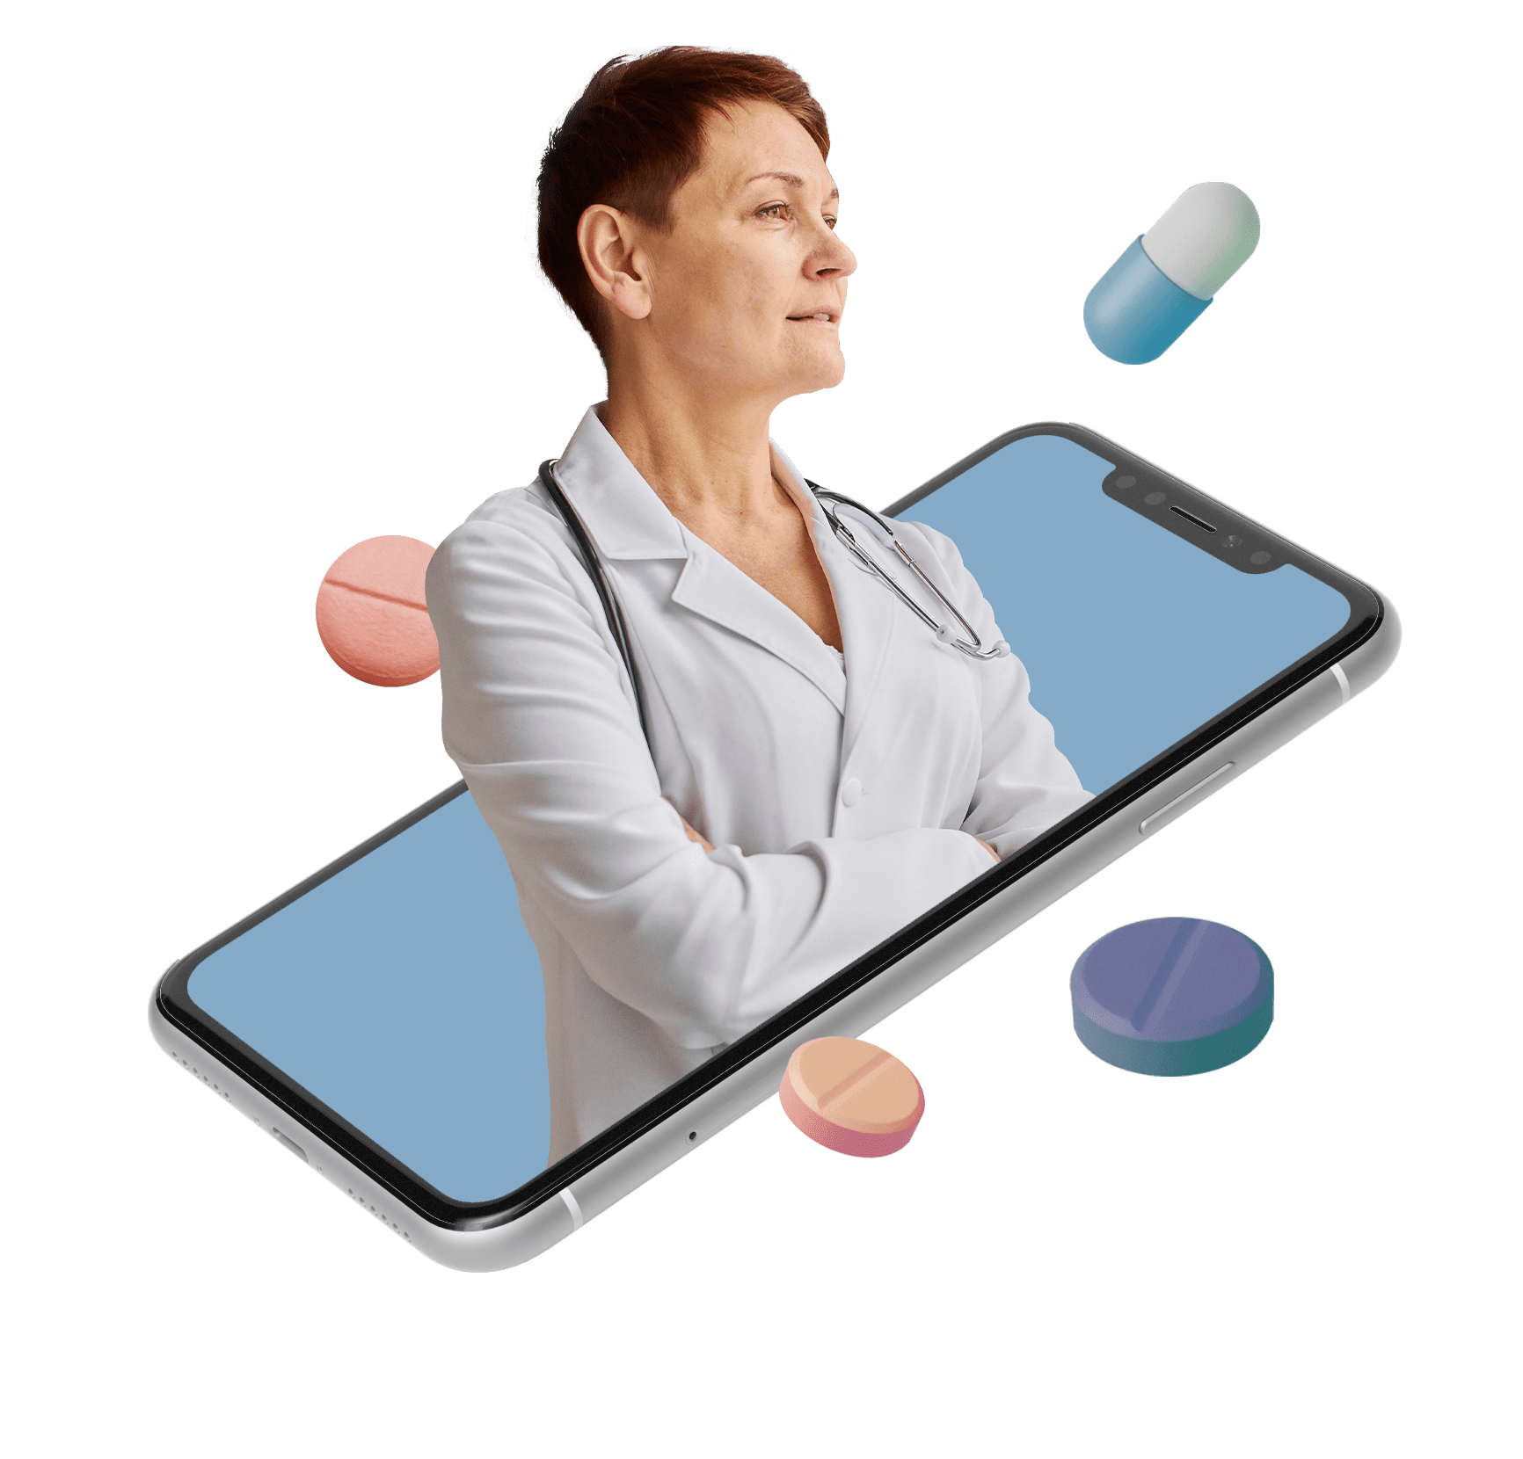
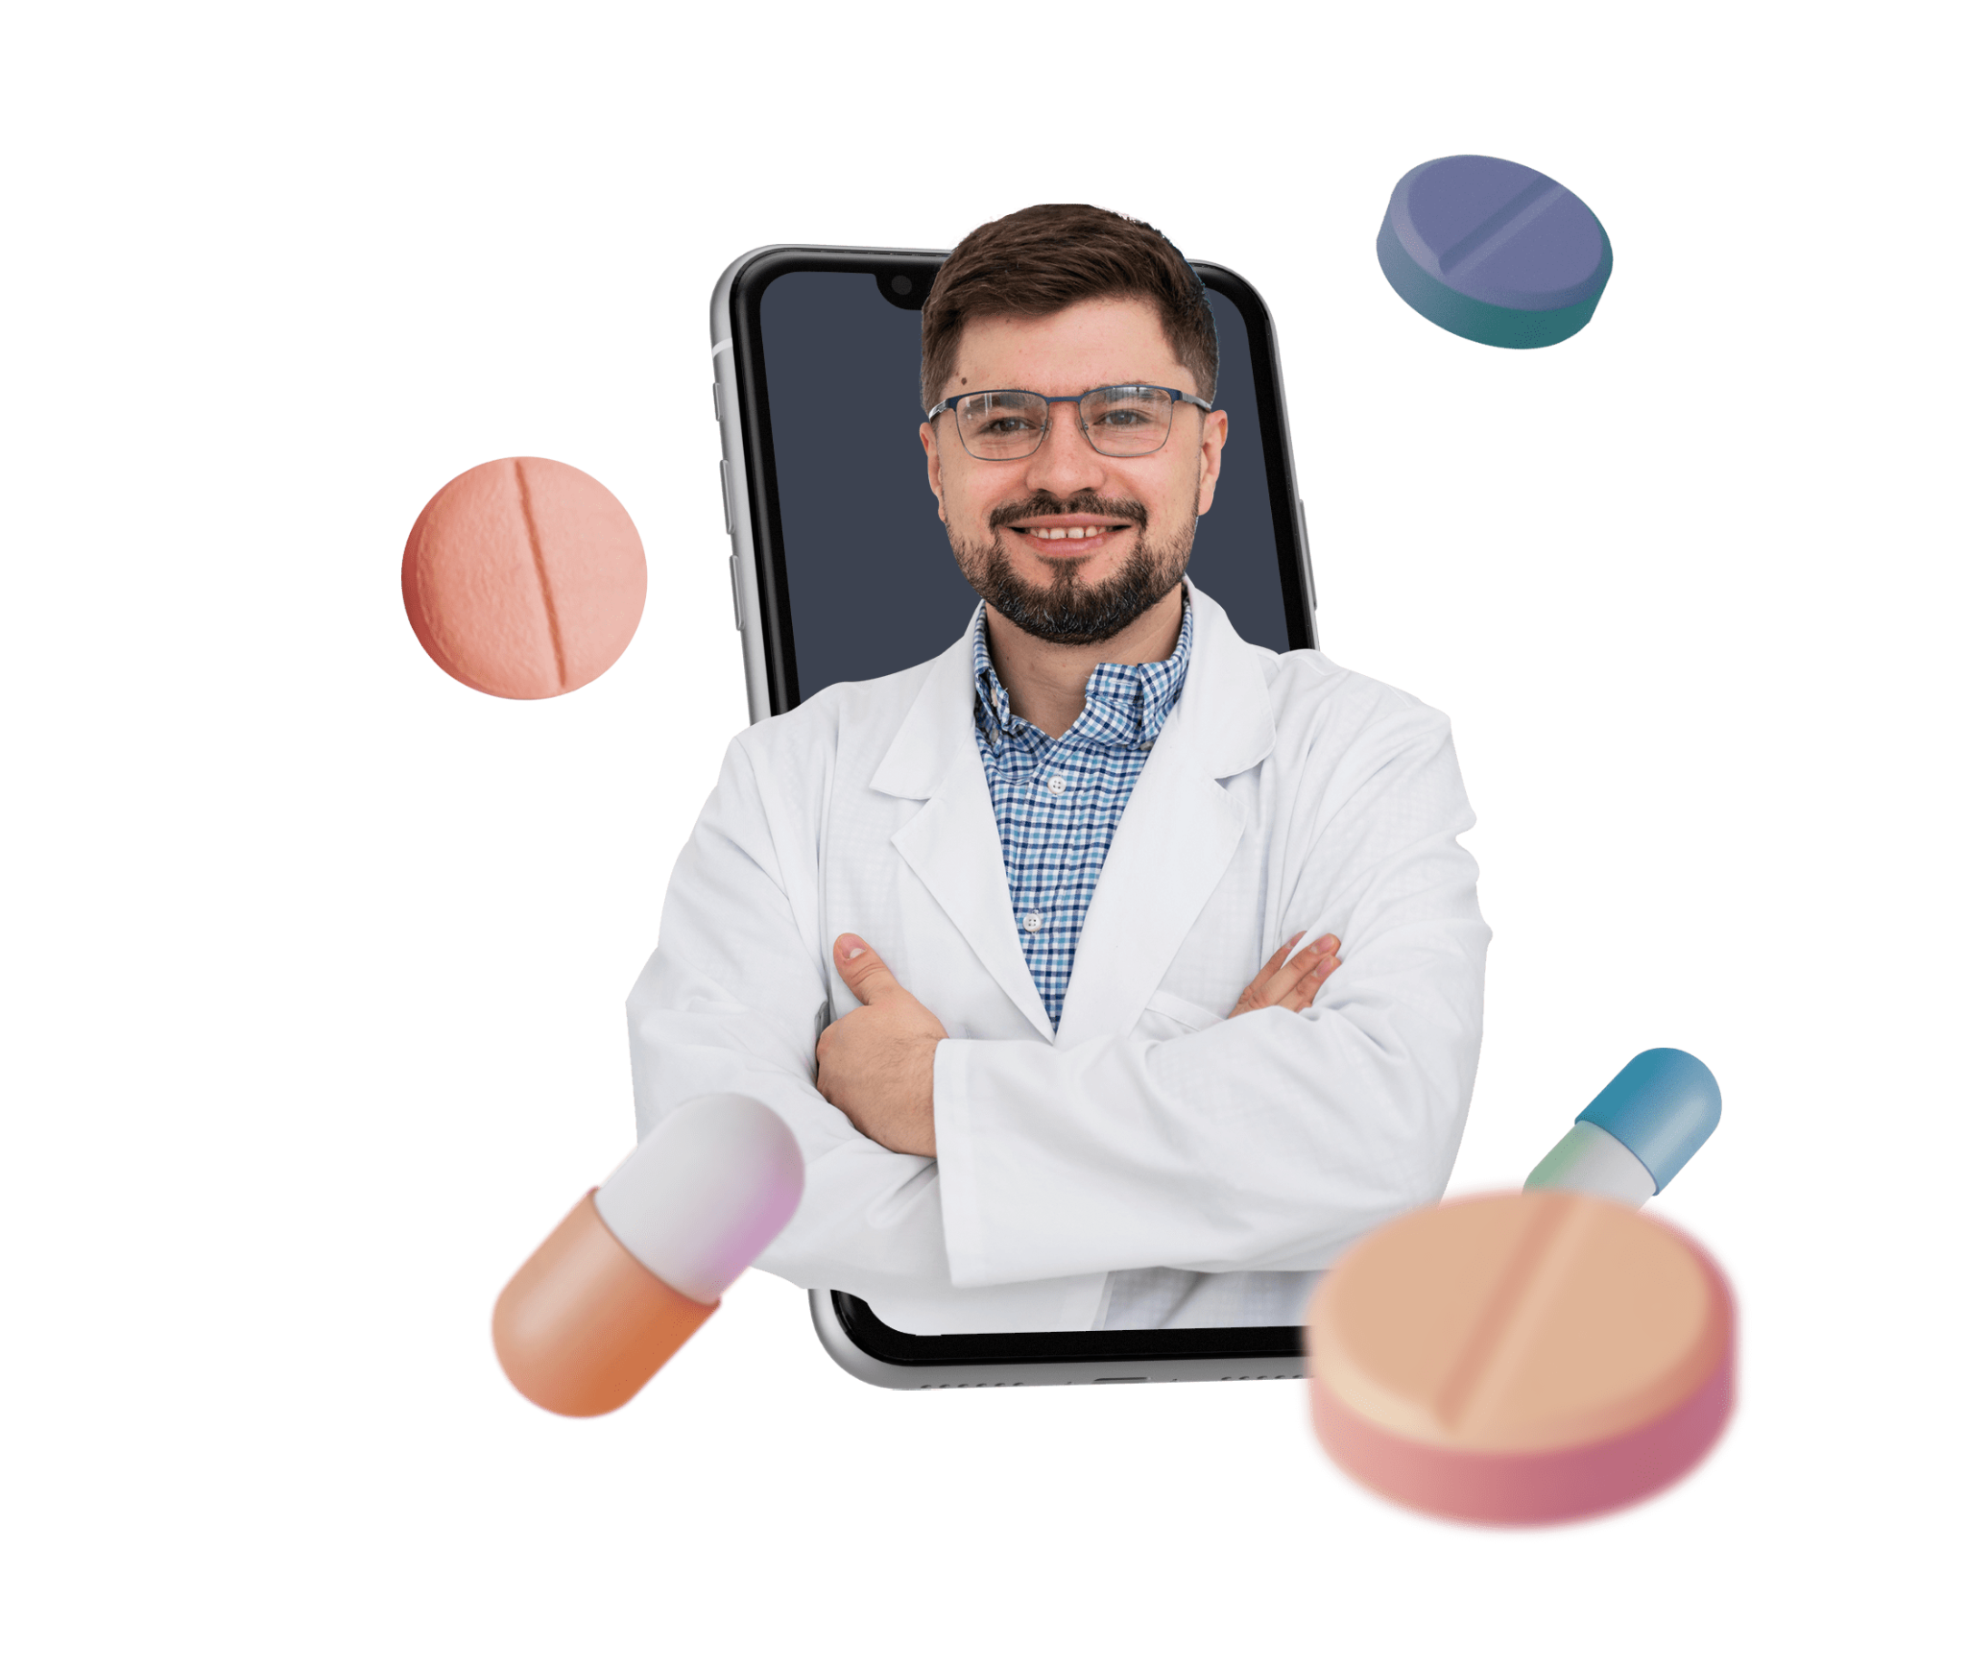
Thanks

